Slide 1

Tackling Transparency and Bias In Healthcare AI using Technical Strategies and Legal Solutions.
Presented By: Project 2 Team.
Notes:
In this presentation we’ll be focusing on the application of AI in Cancer Imaging.

Slide 2

Understanding Bias In Healthcare AI
Bias in AI, particularly in healthcare AI, refers to the systematic and unfair discrimination against certain individuals or groups, leading to disparities in healthcare outcomes, treatment, and access.
Notes:
Bias in AI, particularly in healthcare AI, refers to the systematic and unfair discrimination against certain individuals or groups, leading to disparities in healthcare outcomes, treatment, and access.
In the context of healthcare, where decisions can have life-or-death consequences, biased AI is a critical concern that can exacerbate existing health inequities.

Slide 3
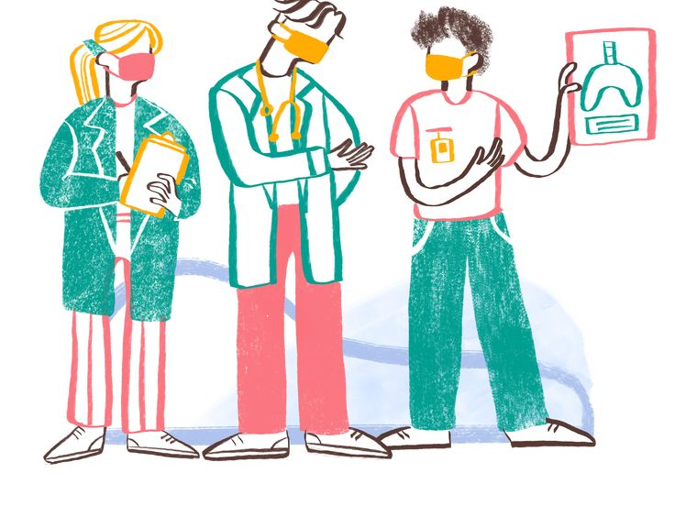
Effects of Bias in Healthcare AI
Misdiagnosis or underdiagnosis in marginalised groups.
Reduced trust in AI tools.
Worsened health disparities.
Suboptimal Treatment Plans.
Unequal Access to Care.
Notes:
The impact of bias in healthcare AI can be severe and contribute to health inequities:
Misdiagnosis and Delayed Treatment: Biased AI can lead to incorrect diagnoses or delays in identifying critical conditions for certain patient groups.
Unequal Access to Care: AI used for risk stratification or resource allocation can unfairly limit access to necessary interventions or specialized care for marginalized populations.
Suboptimal Treatment Plans: Biased AI recommendations can result in treatment plans that are less effective or even harmful for certain individuals.
Erosion of Trust: When AI systems exhibit bias, it erodes trust between patients and healthcare providers and can deepen existing mistrust in healthcare systems among marginalized communities.
Exacerbation of Health Disparities: By perpetuating and amplifying existing biases, healthcare AI can worsen health inequities and contribute to poorer health outcomes for vulnerable populations.
Addressing bias in healthcare AI is not just a technical challenge but an ethical and societal imperative. It requires a concerted effort involving diverse stakeholders to ensure that AI is developed and deployed in a way that promotes fairness, equity, and trustworthy healthcare for all.

Slide 4
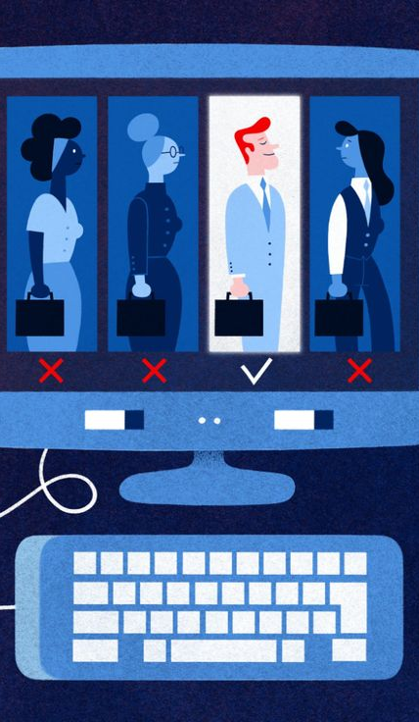
Sources of Bias
Data: Non-representative or imbalanced datasets.
Algorithms: Design choices, parameter settings.
Human input: Implicit assumptions by developers.
Notes:
Data Bias: If the data used to train an AI model reflects historical prejudices or is unrepresentative of certain groups, the model will learn and perpetuate those biases.
Algorithmic Bias: Bias can be introduced through the design and parameters of the algorithm itself, even if the data is seemingly unbiased. This can happen through the features the algorithm prioritizes or the way it processes information.
Human Decision Bias: The biases of the people who design, develop, and deploy AI systems can unconsciously influence the data collection, labeling, and model development processes.

Slide 5

Fairness
Fairness ensures that AI systems treat individuals and groups equitably, without unjustifiable adverse impacts based on characteristics such as race, gender, age, religion, disability, socioeconomic status, or other sensitive attributes.

Slide 6
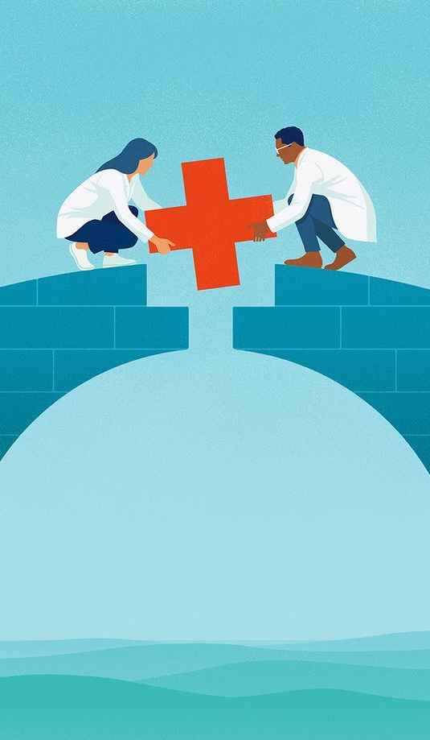
Why is Fairness In Healthcare AI Important?
Prevents discrimination in healthcare outcomes.
Promotes health equity.
Enhances public trust in AI diagnostics.
Legal and ethical compliance (e.g., non-discrimination laws).
Supporting Clinical Decision-Making

Slide 7

Transparency in Healthcare AI
Transparency in healthcare AI is the principle of ensuring that the design, development, and operation of AI systems used in healthcare are open, understandable, and accessible to relevant stakeholders like the patients, healthcare professionals, regulators, and the public.
It goes beyond simply knowing that AI is being used; it involves understanding how and why AI is being applied and the implications of its use in medical settings.
Notes:
Transparency in healthcare AI is the principle of ensuring that the design, development, and operation of AI systems used in healthcare are open, understandable, and accessible to relevant stakeholders.
These stakeholders include patients, healthcare professionals, regulators, and the public.
It goes beyond simply knowing that AI is being used; it involves understanding how and why AI is being applied and the implications of its use in medical settings.

Slide 8

Challenges to Achieving Transparency in Healthcare AI
Complexity of AI Models.
Balancing Transparency with Intellectual Property.
Data Privacy and Security
Diverse Stakeholder Needs
Dynamic Nature of AI
Lack of Standardization
Notes:
Complexity of AI Models: Many advanced AI models are inherently complex and difficult to fully explain in simple terms.
Balancing Transparency with Intellectual Property: Developers of AI healthcare solutions have legitimate concerns about protecting their proprietary algorithms.
Data Privacy and Security: Sharing detailed information about the training data to enhance transparency must be balanced with protecting sensitive patient information and complying with privacy regulations like GDPR and HIPAA.
Diverse Stakeholder Needs: Different stakeholders (patients, clinicians, regulators) require different levels and types of transparency, making it challenging to satisfy everyone.
Dynamic Nature of AI: Some AI models are continuously learning and evolving, making it difficult to provide a static, fully transparent explanation of their current state.
Lack of Standardization: There is a need for standardized frameworks and guidelines for achieving and communicating AI transparency in healthcare.

Slide 9

Mitigating Bias and Achieving Fairness & Transparency using Legal and Technical Tools.
Implement GDPR/Consent Tech: Build systems for clear consent opt-in/out, minimal data collection, and secure data handling as legally required by GDPR.
Audit Data & Guide Collection: Audit datasets for bias regularly and work to ensure data collection is representative.
Apply Fairness Tech: Implement algorithmic techniques and fairness metrics such as demographic parity during model building to mitigate bias.
Integrate Explainability: Use tools like SHAP and LIME to make model decisions understandable.
Build Traceability: Design systems to track data and model versions for accountability.
Co-Design & Monitor: Engage in co-design with users (like clinicians/patients) and implement continuous fairness monitoring.

Slide 10
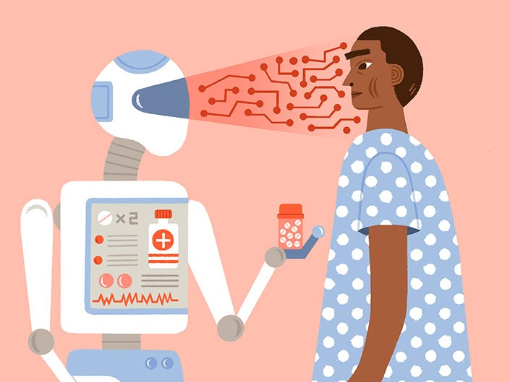
Applications of AI in Cancer Imaging.
Detection & Diagnosis
Identifying cancerous lesions or tumours in medical scans (e.g. mammograms, CT, MRI).
Supporting radiologists in distinguishing between benign and malignant cases.
Segmentation
Precisely outlining tumours and other regions of interest in scans.
Helps in planning treatment and tracking tumour progression.
Classification
Categorising tumour types, stages, or aggressiveness based on imaging features.
Assists in tailoring personalised treatment plans.
Prognosis Prediction
Analysing imaging patterns to estimate disease progression and survival outcomes.
Treatment Response Monitoring
Comparing imaging data over time to assess how well a patient is responding to therapy.
Notes:
AI is revolutionising cancer care through several key applications in imaging:
Detection & Diagnosis
Identifying cancerous lesions or tumours in medical scans (e.g. mammograms, CT, MRI).
Supporting radiologists in distinguishing between benign and malignant cases.
Segmentation
Precisely outlining tumours and other regions of interest in scans.
Helps in planning treatment and tracking tumour progression.
Classification
Categorising tumour types, stages, or aggressiveness based on imaging features.
Assists in tailoring personalised treatment plans.
Prognosis Prediction
Analysing imaging patterns to estimate disease progression and survival outcomes.
Treatment Response Monitoring
Comparing imaging data over time to assess how well a patient is responding to therapy.

Slide 11

Benefits of Using AI in Cancer Imaging
Early Detection: AI can identify patterns not visible to the human eye, improving early diagnosis.
Improved Accuracy: Reduces errors and increases diagnostic confidence.
Efficiency: Speeds up image analysis, reducing radiologist workload.
Consistency: Delivers more standardised interpretations across different patients and clinicians.
Support for Personalised Care: Helps tailor treatment based on tumour type and response prediction.

Slide 12
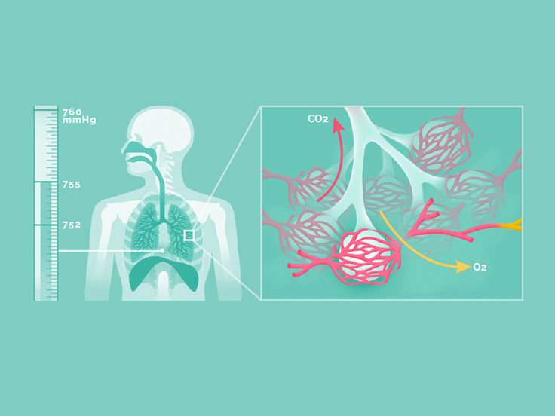
Challenges of Using AI in Cancer Imaging
Bias in Training Data: AI may underperform in underrepresented groups, leading to unequal care.
Lack of Transparency: Complex models like CNNs are often “black boxes,” hard to interpret.
Overfitting Risks: Models might perform well on training data but poorly in real-world settings.
Regulatory and Ethical Concerns: Ensuring AI is safe, fair, and legally compliant remains an ongoing challenge.
Dependence on Data Quality: Poor-quality or inconsistent imaging data can reduce model effectiveness.
Notes:
In CNNs, the "black box" refers to the difficulty in understanding the specific reasons or features that led the network to make a particular prediction or decision, even though you can see the input data and the final output.
Think of it like this: you give the CNN an image of a potential tumor, and it tells you "Malignant." You know the input (the image) and the output (the classification), but it's hard to pinpoint exactly which complex combination of learned features across its many layers (edges, textures, shapes, etc.) contributed most to that "Malignant" decision.
The opacity comes from the intricate, non-linear interactions between the vast number of neurons and parameters within the hidden layers of the deep network. While powerful for learning complex patterns, this depth makes it challenging for humans to follow the step-by-step reasoning process.

Slide 13

Conceptual Framework of a Fair and Transparent AI Cancer Imaging Model

Slide 14

1. Input Stage – Data Collection
Risk of Bias
Underrepresentation of certain populations (e.g. race, gender, age).
Imaging quality differences (different equipment across hospitals).
Solutions
Diverse, representative datasets.
Apply data harmonization to images so they are more consistent across different sources.
Regular bias audits on data distributions.
Consent control mechanisms for patient data usage (GDPR compliant).
Notes:
Fairness Metrics (to measure and define fairness):
Demographic Parity (Statistical Parity): Measures if a positive outcome is equally likely across different groups.
Equal Opportunity: Measures if the true positive rate (correctly identifying positive cases) is the same across different groups.
Equalized Odds: Requires both the true positive rate and the false positive rate to be equal across groups.
Predictive Parity: Measures if the positive predictive value (proportion of positive predictions that are truly positive) is the same across groups.
Algorithmic Techniques (to build fairness into the model):
Pre-processing Techniques: Adjusting the training data before feeding it into the model to reduce bias (e.g., re-sampling, re-weighing data points).
In-processing Techniques: Modifying the training algorithm or the model's objective function to incorporate fairness constraints during training.
Post-processing Techniques: Adjusting the model's predictions after the model has been trained to improve fairness according to a chosen metric.
Adversarial Training: Training two competing networks, one to perform the main task and another to try and detect sensitive attributes, encouraging the main network to be independent of those attributes.
Developing Models Robust to Variability: Designing AI model architectures and training processes that are inherently more resilient to noise and variations in input data. This can involve using specific types of layers, regularization techniques, or loss functions during training.
Data Harmonization: This involves applying pre-processing techniques to the images to make their characteristics more consistent across different sources. This can include normalizing image intensities, standardizing spatial resolution, or using algorithms to correct for scanner-specific artifacts or variations in contrast. The goal is to reduce the non-biological variability in the data before training the AI.

Slide 15
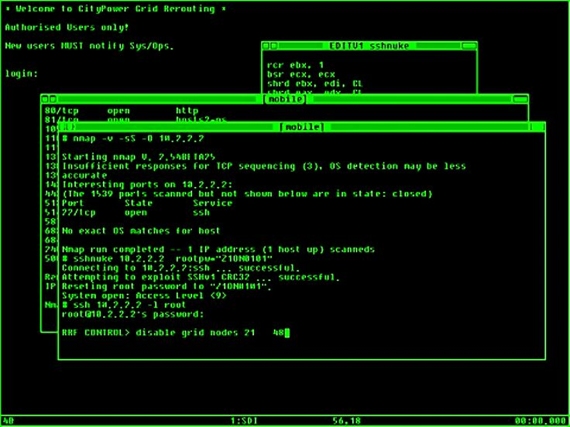
2. Model Development – Algorithms Used (CNNs, SVMs)
Risk of Bias
CNNs may learn spurious correlations (e.g. hospital-specific artefacts).
SVMs sensitive to hyperparameter tuning and outliers.
Solutions
Use SHAP (SHapley Additive exPlanations) to explain model outputs.
Use LIME (Local Interpretable Model-agnostic Explanations) for individual predictions.
Regular cross-group performance testing (e.g., across race/gender groups).
Embed non-discrimination checks as part of model validation.
Notes:
SHAP shows you which specific pixels or areas (features) in that image were most important in pushing the AI towards its final decision, like classifying a tumor as malignant. It highlights their impact compared to a baseline prediction Imagine you have a very complex machine you can't see inside (the black box AI). You give it something (like a medical image), and it gives you an answer (like "malignant").
LIME helps you understand why it gave that specific answer for that specific input.
It works by slightly changing your input many times and seeing how the machine's answer changes. Based on these slight changes and the resulting answers, LIME builds a simple, understandable model just for that specific input and its close variations.
This simple model then shows you which parts of your input were most important in influencing the complex machine's decision for that one case. It's like shining a flashlight on a small part of the complex machine to see what's happening there.

Slide 16
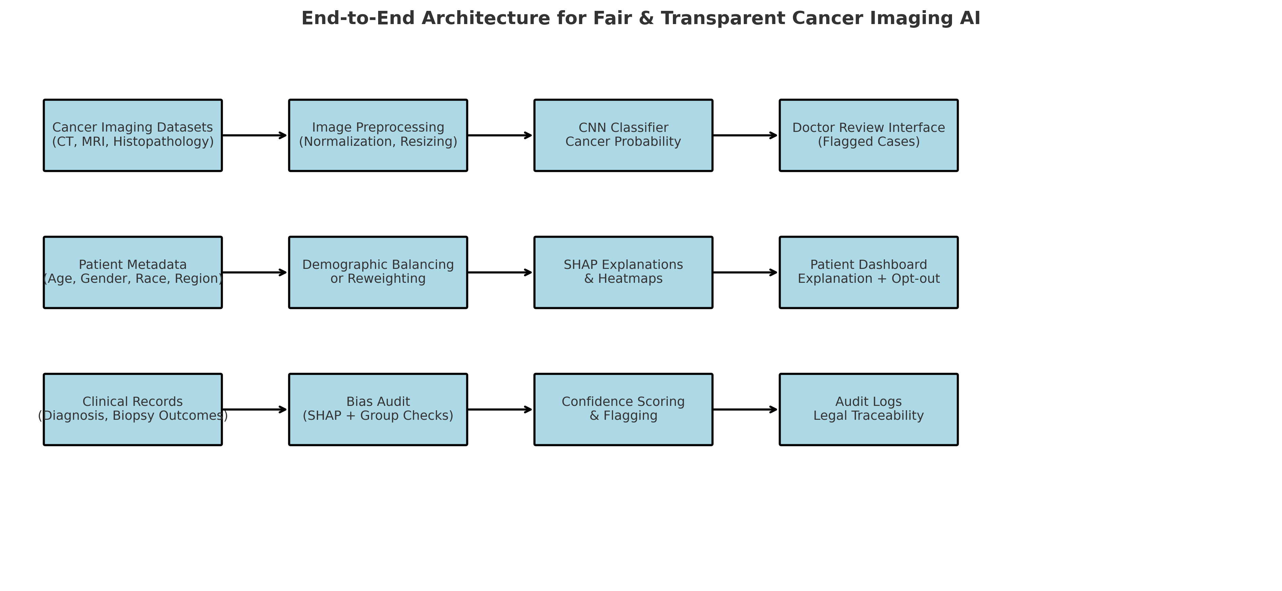
System Architecture of a Fair & Transparent Cancer Imaging AI

Slide 17
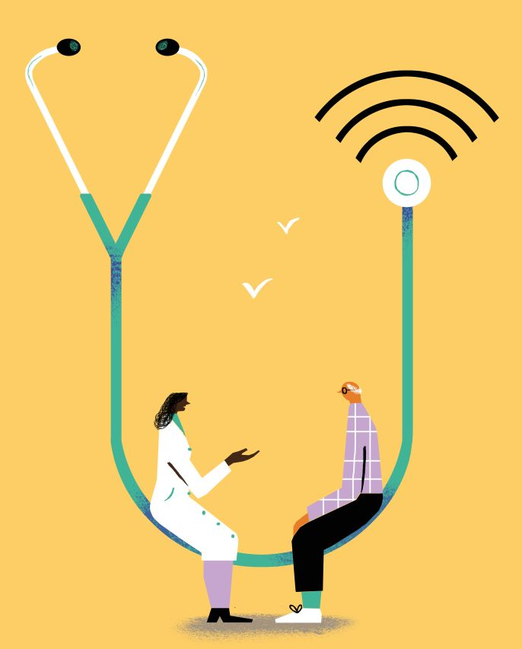
3. Output – Diagnosis & Prediction
Risk
Misdiagnosis affecting marginalised groups more.
Unexplainable model decisions.
Solutions
Model evaluation metrics across demographic groups
Flagging uncertainty levels in predictions
Using SHAP to create audit trails of the AI decision-making process.

Slide 18
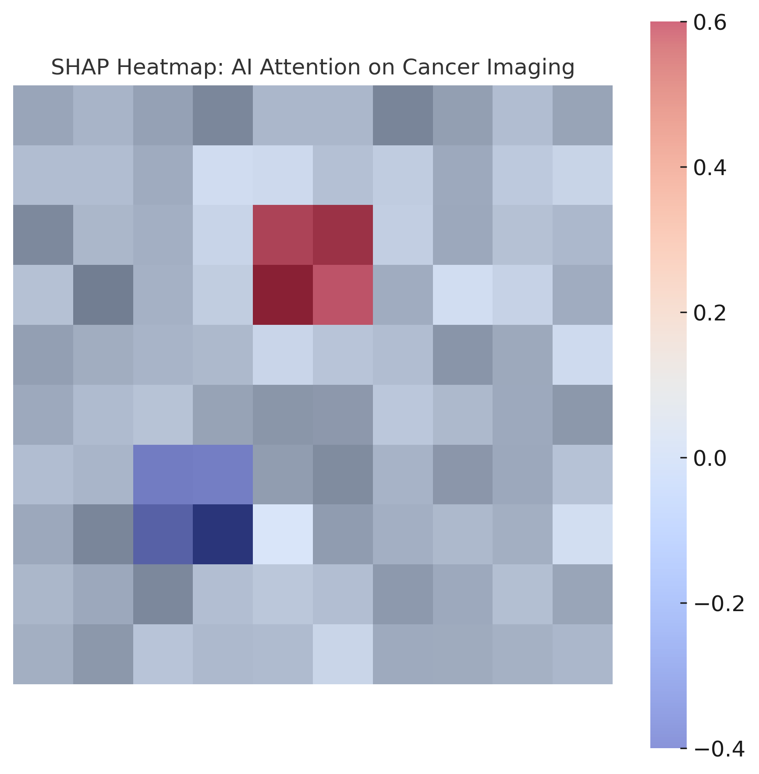
Example of a SHAP Heatmap explaining AI on a Medical Image.

Slide 19
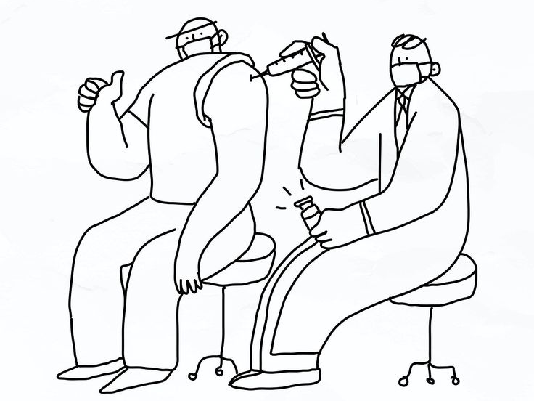
4. Transparency & Fairness Mechanisms
Technical
Model cards (documentation of model purpose, training data, limitations)
Datasheets for datasets (what's in them, how collected, who it represents)
Legal:
GDPR: Right to explanation, data minimisation, explicit consent.
Bias audits required before deployment.
Compliance with medical device regulation
(e.g. MHRA in the UK, FDA in the US).

Slide 20
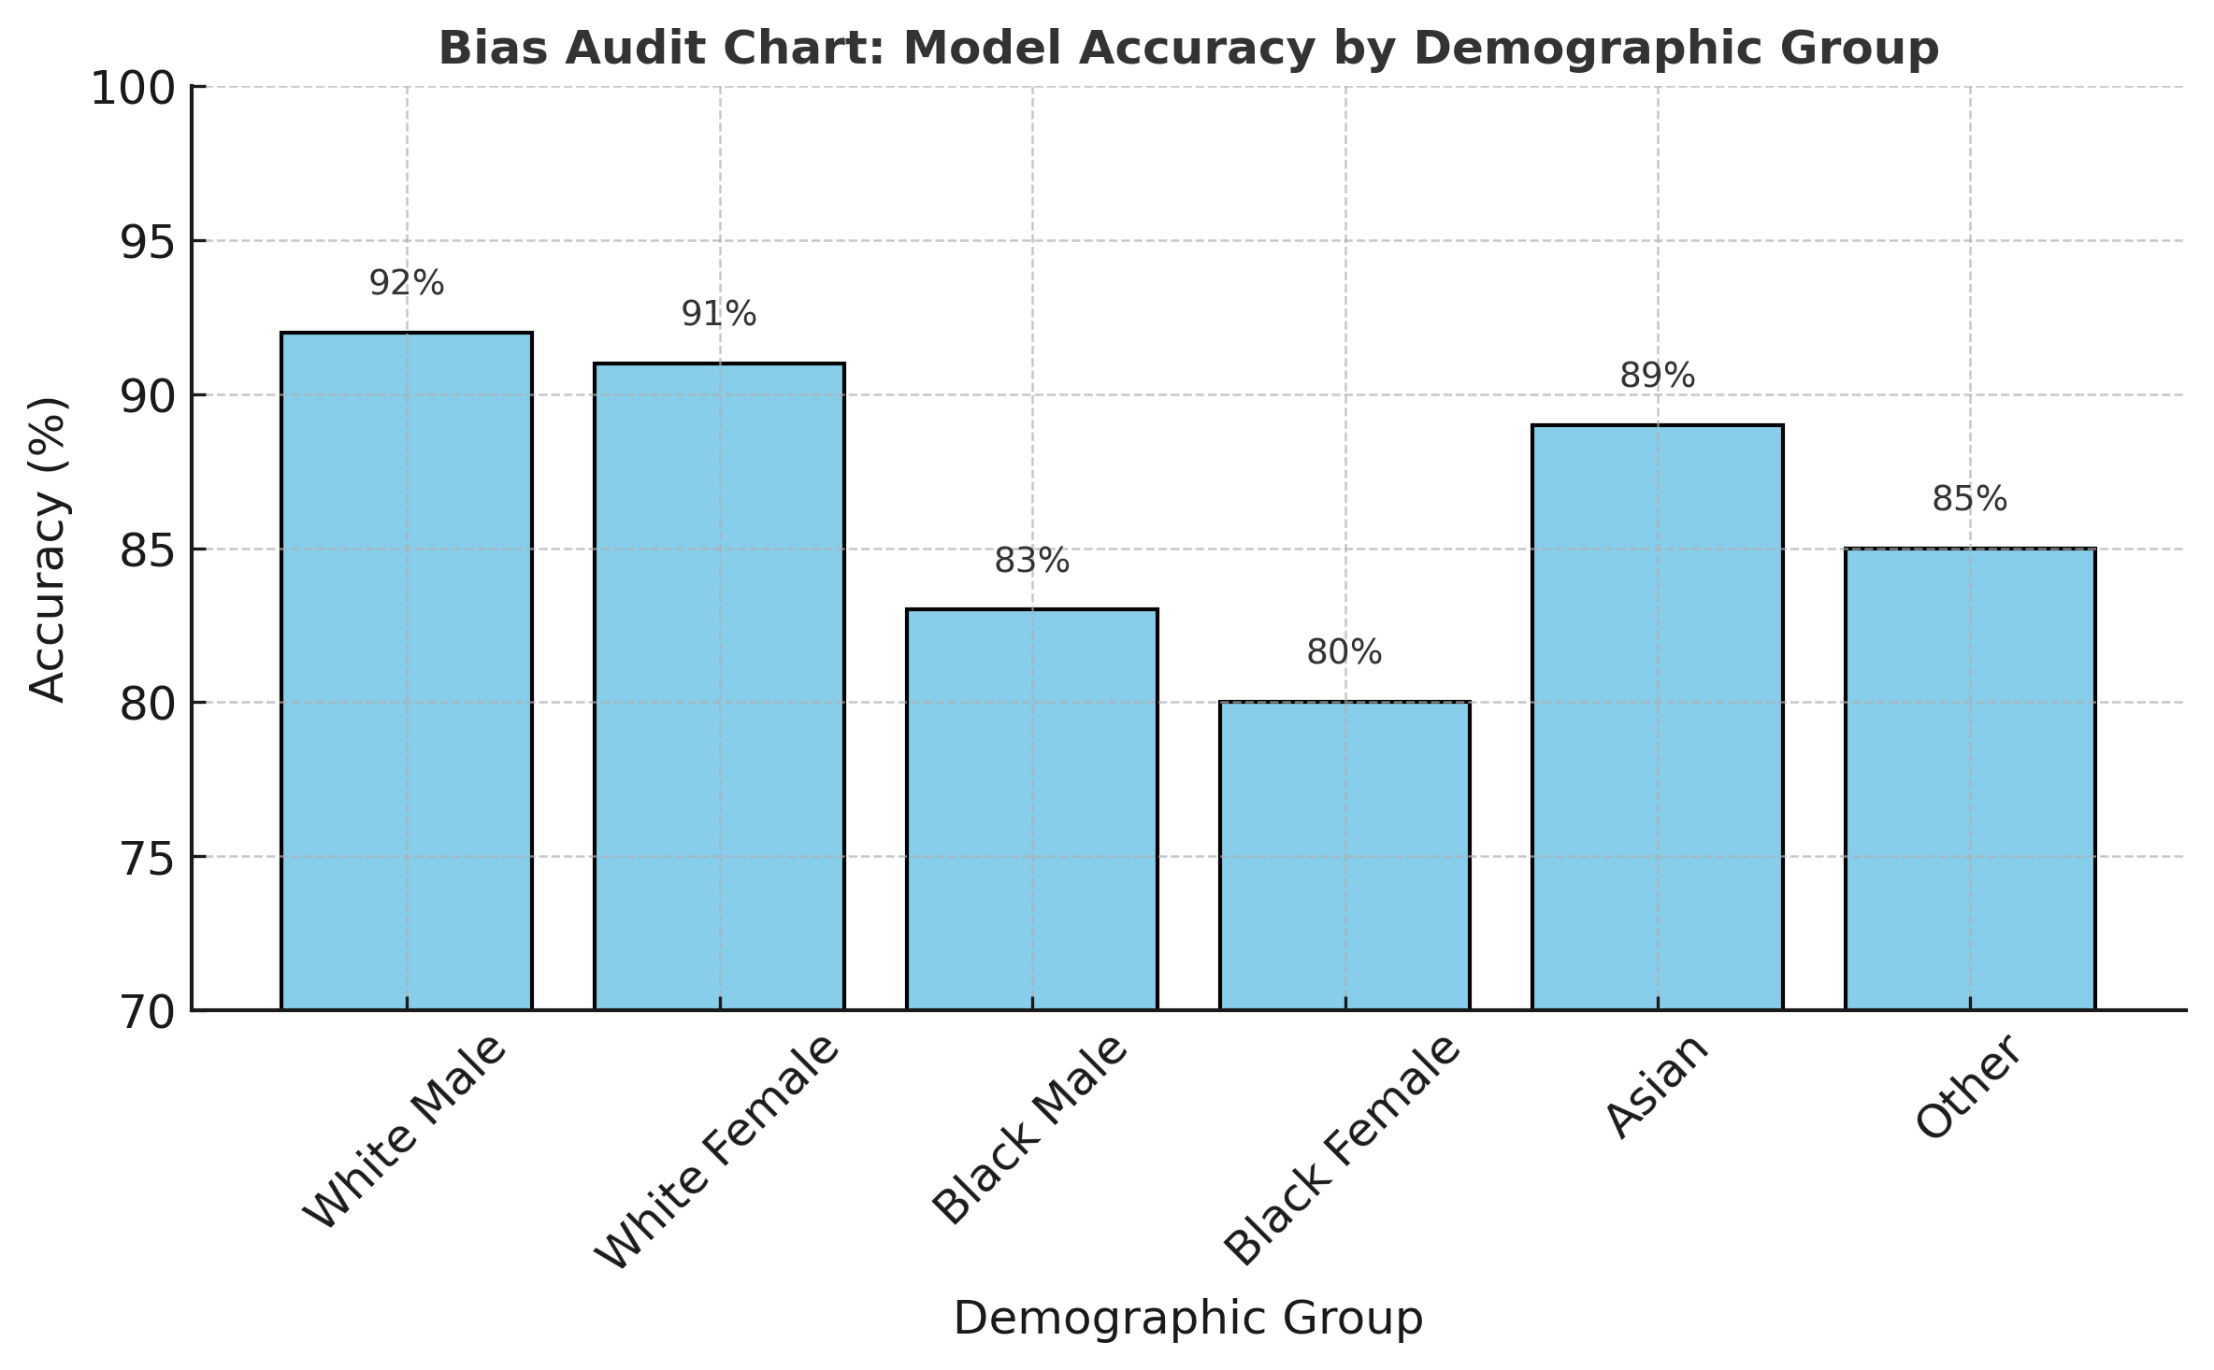
Example of a Bias Audit Chart

Slide 21

5. Governance & Monitoring
Establish a Healthcare AI Ethics Board.
Continuous post-deployment monitoring.
Update models based on new data or emerging inequalities.
Involve patients and clinicians in co-design processes.

Slide 22
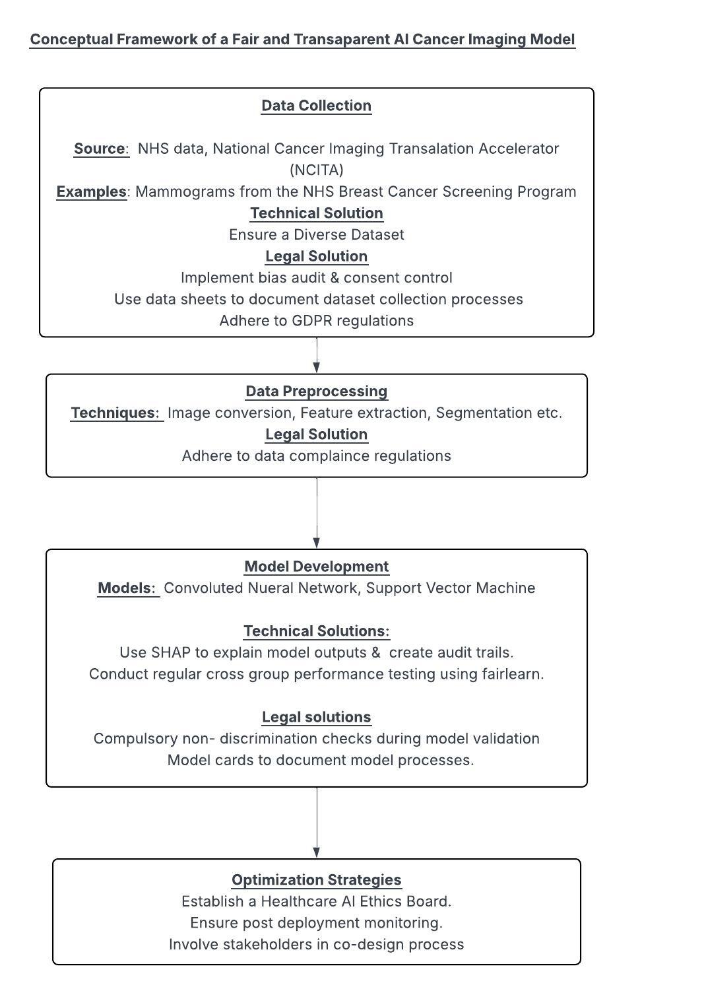

Slide 24


